Slide 1

AI based Infrastructure Administration.
Group No. : 12
Manasi Ghadge(16104019)
Anuja Dhumale(16104034)
Gitika Daki(16104005)
Project Guide : Prof. Apeksha Mohite
Project Co-guide : Prof. Nahid Shaikh

Slide 2
Contents
Abstract
Introduction
Objectives
Literature Review
Problem Definition
Existing System Working
Proposed System Working
Technology stack
Scope of project
References

Slide 3
ABSTRACT
In any organization whether a school or university it is important that the students are edified in a congruous infrastructure. This accounts that the respective infrastructure should consummate all the requisites as essential or required by the students or the faculties.Till date all this process is done manually and is sometimes inclined to commit mistakes. In order to eschew mistakes it is reliable to have a computer availed web-predicated system that will monitor the infrastructure allotment taking into account.

Slide 4
INTRODUCTION
AI based Infrastructure administration is developed for the college to simplify the allotment of practical infrastructure. It fixates on efficient allotment of infrastructure considering software requisites of each infrastructure as well each subject and students capacity of each infrastructure.Allotment is done utilizing an AI based chatbot. Here, AI chatbot will work as a mediator between user and system. It will accept queries from users and will give results. This system will make infrastructure allotment process easy by reducing manual work.

Slide 5
OBJECTIVES
To provide an efficient and intelligent system for infrastructure allotment.
To curb the problem of manual labour.
To overcome with the problem of delay in traditional system.
To understand user requirements and according allot suitable infrastructure for a particular purpose.
To suggest swaps incase if any infrastructure is not available in runtime.
To provide smart solution in less time.

Slide 6
LITERATURE REVIEW
1. Title :Automatic timetable generator.
Authors:Saritha M,Pranav Kiran Vaze.Pradeep,Mahesh N R.
Publication details:International Journal of Advanced Research in Computer Science and Software Engineering, Volume 7, Issue 5, May 2017,ISSN: 2277 128X
Findings:Genetic Algorithm.
Advantages:Generates timetable for each class and teacher, in keeping with the availability calendar of teachers, availability and capacity of physical resources.It is developed to manage all periods automatically.
Disadvantages:It is a messy system as large number of users are logged in.

Slide 7
2.Title:Timetable generation and Leave management system.
Authors:Shashikala K,Shruthi C R,Vinutha N,Roopalakshmi S.
Publication details:ISSN(Online)2394-2320 International Journal of Engineering Research in Computer Science and Engineering (IJERCSE) Vol 5, Issue 6, June 2018
Findings:Scheduling algorithm.
Advantages:Provides leave management for students as well as faculty.
Disadvantages:Paid and costly application and had unwanted additional features.

Slide 8
3. Title:Automatic and effective allocation for examination seats.
Authors:Neelkanth Sharma,Abhishek Mahale,Ashwini Andhale,Yogesh Joshi.
Publication details:International Journal of Engineering Research and Management (IJERM) – Volume 3 Issue 5- May 2017
Findings:Parsing Algorithm.
Advantages:Developed to allot seats for students in which block they are assigned and a notification is send to students as well as faculties.
Disadvantages: Maintenance of database becomes tedious.

Slide 9
4.Title:Timetable Generator.
Authors:Albert Chai Meng Fatt,Chai Wee Kee,Lee Chee heong
Publication details:Prakash School of Computer Engineering Nanyang Technological University Singapore - 639 798.
Findings: Rational Rose CASE tool,UML notation.
Advantages:Generates all combinations of timetable .
Disadvantages:The system was not feasible in universities more than 100 classrooms.

Slide 10
5.Title:Review of integrated applications with AIML based chatbot.
Authors:Md.Shahriare Satu, Md. Hasnat Parvez, Shamim-AI-Mamun
Publication details:1st International Conference on Computer & Information Engineering, 26-27 November,2015.
Findings:AIML
Advantages:Ease of use.
Disadvantages:Cannot be used for large-sized projects.

Slide 11
PROBLEM DEFINITION
Commencement of drive or sundry academic programs without any prior
information results in shortage or sometimes unavailability of infrastructure
resources. This stresses the manpower and engenders a hustle in convention
and schedule as manual communication and faculty coordination is involved for making any subtle changes. To overcome with this quandary we will providing a web based application for efficient allotment of infrastructure.‘AI based Infrastructure Administration’ will be integrated with an AI chatbot for utilizer interaction. Our solution will withal provide comfort to the manpower and will evade hamper in academics.

Slide 12
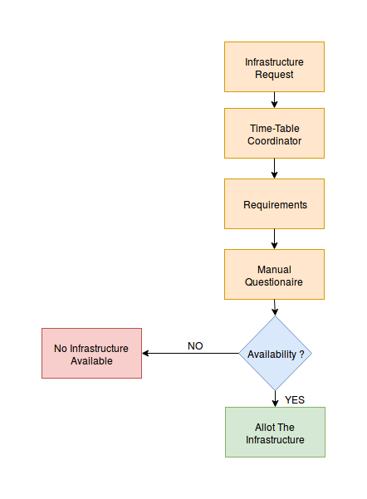
EXISTING SYSTEM WORKING

Slide 13
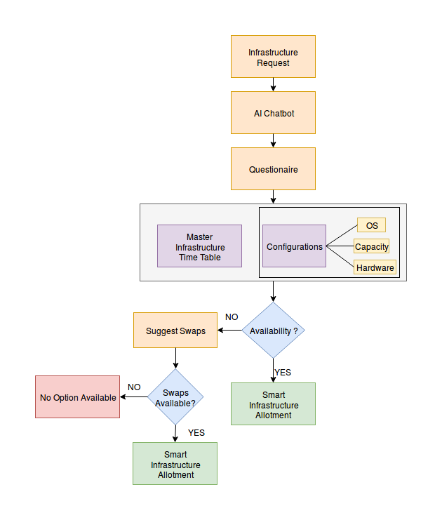
PROPOSED SYSTEM WORKING

Slide 14
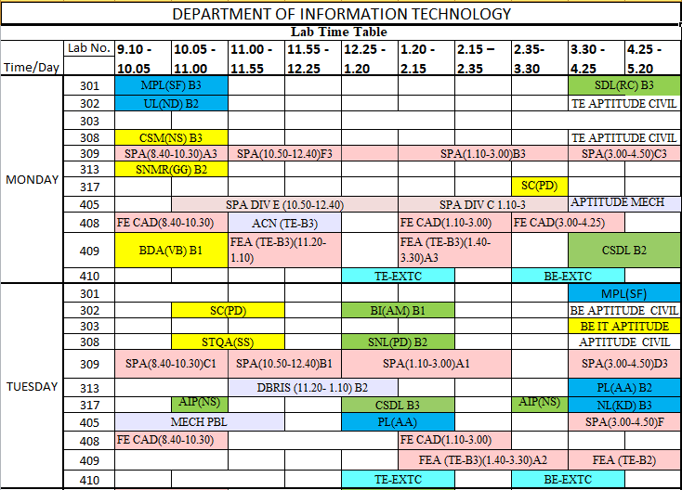
MASTER INFRASTRUCTURE TIMETABLE

Slide 15
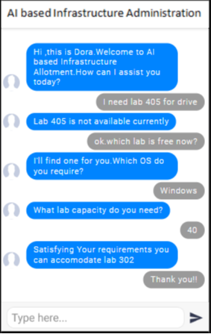
CHATBOT INTERACTION WITH USER

Slide 16
TECHNOLOGY STACK
Software Specification:
Artificial Intelligence for Chatbot.
Front end for GUI designing of AI based Infrastructure Administration can be developed using HTML5,CSS3,Jquery.
For the purpose of database storage and data fetching Python 3,MySQL,PHP can be used.
Hardware Specification:
Processor – Dual Core
Hard Disk – 50 GB
Memory – 1GB RAM

Slide 17
SCOPE
Proposed System will withal provide comfort to the manpower and will evade hamper in academics.
Provides with an AI Chatbot in runtime of academics.
It will avail eschew inconsistencies visually perceiving that no lab session is missed due to any reason by providing alternate infrastructure options.
Additionally features provided like reservation and dynamic allocation due to any activities.

Slide 18
REFERENCES
Saritha M, Pranav Kiran Vaze, Pradeep, Mahesh N R,on”Automatic Time Table Generator”,International Journal of Advanced Research in Computer Science and Software Engineering, Volume 7, Issue 5, May 2017,ISSN: 2277 128X
Shashikala K,Shruthi C R,Vinutha N,Roopalakshmi S on“Timetable Generation and Leave Management System”,ISSN(Online)2394-2320 International Journal of Engineering Research in Computer Science and Engineering (IJERCSE) Vol 5, Issue 6, June 2018
Neelkanth Sharma,Abhishek Mahale,Ashwini Andhale,Yogesh Joshi on “Automatic and Effective Allocation for Examination Seats using Android Application” International Journal of Engineering Research and Management (IJERM) – Volume 3 Issue 5- May 2017

Slide 19
Albert Cliai Meng Fatt, Chia Wee Kee, Lee Chee Heong, Ng How Seng, Karen Ng Sor Har, Puah Suet Ni, Alvis Yeo Kok Yong, Mark Yeo Soon Hock, and Edmond C on“SOFTWARE ENGINEERING APPROACH FOR A TIMETABLE GENERATOR” Prakash School of Computer Engineering Nanyang Technological University Singapore - 639 798.
Md.Shahriare Satu, Md. Hasnat Parvez, Shamim-AI-Mamun on Review of integrated applications with AIML based chatbot 1st International Conference on Computer & Information Engineering, 26-27 November,2015.

Slide 20
Thank You...!!

